Slide 1
Lecture 0 - Introduction
AI in Genetics
ZOO6927 / BOT6935 / ZOO4926

Slide 2
AI in Genetics Fall 2024
ZOO6927 / BOT6935 / ZOO4926
Class Number 29890 / 29408 / 29411
Tuesday | (3:00 PM - 4:55 PM)
Thursday | (3:00 PM - 3:50 PM)
Room: FAC127

Slide 3
Zoom link for remote students: https://ufl.zoom.us/j/6424255698
Please attend in person if you are on the main campus

Slide 4
Juannan Zhou, Assistant Professor
Department of Biology
E-mail: juannanzhou@ufl.edu
Office: Bartram 122
Office Hours: Thursday 4:00-5:00 PM

Slide 5
Communication
Course Slack channel:
Please send me your email with title “Slack - AI in Genetics”
Course site: https://github.com/juannanzhou/AI-in-genetics

Slide 6
Course objective
Comprehensive overview of applications of modern machine learning techniques in various areas of genetics.
Provide opportunities for students to
integrate machine learning into their own research
learn critical computational and statistical skills that will hopefully broaden the student’s career path.

Slide 7
Deliberables
Objectives of the course will be achieved if, by its conclusion, students can:
Understand the basic concepts and mathematical/statistical theory behind modern machine learning methods
Understand 80% of most research papers in fields relevant to the student’s own research,
Grasp the basic ideas of technical machine learning papers

Slide 8
Deliberables
Develop new research questions well-suited for applying machine learning methods to improve their current studies; or identify existing questions where machine learning offers a potentially superior alternative to the current approaches.
Identify the right machine learning frameworks and tools for answering these questions
Build machine learning models to solve specific questions using coding languages such as Python
Get the model to work by using different model architectures and training methods

Slide 9
Topics
The course will cover applications of AI to genomics, gene expression and regulation, protein design and evolution, molecular evolution, disease/cancer genetics, population, and quantitative genetics.

Slide 10
Course format
Unit 1: Concise introduction to the mathematical and statistical foundations of modern machine learning.
Unit 2: Student-led paper discussions on different areas of AI in genetics.

Slide 11
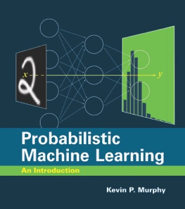
Textbook (recommended)
Probabilistic Machine Learning: An Introduction by Kevin Murphy. MIT Press, March 2022.
Free pdf: https://github.com/probml/pml-book/releases/latest/download/book1.pdf

Slide 12
Exam
One mid-term exam. The grade of the mid-term exam will account for 40% of the student’s final grade.
Format of the exam will be take-home and consists of of conceptual and practical questions the student needs to solve using their preferred coding language.

Slide 13
Student-led paper discussion
Each student will be responsible for leading an in-class discussion on one of the assigned readings.
This will account for 10% of final grade.
Sign up for a paper from a curated list
Or nominate a paper!
Sign up for/nominate a paper here
https://docs.google.com/spreadsheets/d/1Auv1KecDHTh7p3GDAcKObnJc-mv3aDeWkuo2J2ONzec/edit?usp=sharing

Slide 14
Final project
Each student is expected to complete a final project, which will make up 50% of the student’s final grade.
Students should apply machine learning techniques to solve a biological problem, preferably directly relevant to their thesis work.
The student will present their results in class and turn in a term paper. The paper should be similar in format to a conference publication (e.g. https://proceedings.mlr.press/v240/).

Slide 15
Final project
Student’s prior fluency in coding/ML and stage in their training will be taken into account
The most important goal is to get you started working on a project that will lead to a publicatioin

Slide 16
Date | Week | Subject | Topics
8/22/24 | 0 | Course introduction; Mathematical foundation | Linear algebra
8/27/24 | 1 | Mathematical foundation | Linear algebra
8/29/24 | 1 | Mathematical foundation | Probability
9/3/24 | 2 | Mathematical foundation | Probability
9/5/24 | 2 | Machine learning basics | Multi linear perceptron; Backprop; Autodiff; Gradient descent
9/10/24 | 3 | Machine learning basics | Training neural networks; Regularization
9/12/24 | 3 | Machine learning basics | Convolutional neural networks
9/17/24 | 4 | Machine learning basics | Language models; RNNs; Transformers
9/19/24 | 4 | Machine learning basics | Graphical neural networks; Generative models
9/24/24 | 5 | Machine learning basics | Generative models
9/26/24 | 5 | Machine learning basics | Non-parametric methods; Gaussian processes
10/1/24 | 6 | Paper discussion | Bioinformatics
10/3/24 | 6 | Paper discussion | Proteins
10/8/24 | 7 | Paper discussion | Proteins
10/10/24 | 7 | Paper discussion | Gene expression and regulation
10/15/24 | 8 | Paper discussion | Gene expression and regulation
10/17/24 | 8 | Paper discussion | Genomics
10/22/24 | 9 | Paper discussion | Genomics
10/24/24 | 9 | Paper discussion | Molecular Evolution
10/29/24 | 10 | Paper discussion | Molecular Evolution
10/31/24 | 10 | Paper discussion | Population Genetics
11/5/24 | 11 | Paper discussion | Population Genetics
11/7/24 | 11 | Paper discussion | Quantitative Genetics; Plant/Animal Breeding
11/12/24 | 12 | Paper discussion | Quantitative Genetics; Human diseases
11/14/24 | 12 | Paper discussion | Generative models in genetics
11/19/24 | 13 | Student presentations
11/21/24 | 13 | Student presentations
11/26/24 | 14 | Thanksgiving break
11/28/24 | 14 | Thanksgiving break
12/3/24 | 15 | Student presentations

Slide 17
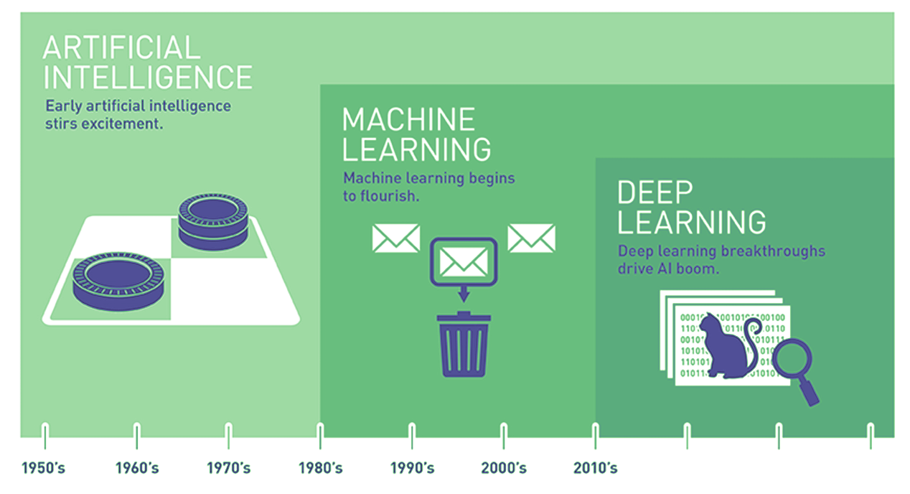

AI is Expansive
Source: Copeland, M. Retrieve from https://blogs.nvidia.com/blog/2016/07/29/whats-difference-artificial-intelligence-machine-learning-deep-learning-ai/
Notes:
The field of AI is expansive…
Often, the terms AI, Machine Learning, and Deep Learning are used interchangeably. But as pictured here, they are nested subsets, with AI encompassing the other two. Indeed, AI has a long and distinguished history. In fact, a lot of interesting AI research happened in the 1950s. Unfortunately, though, progress has been uneven – as we will soon see.
Let’s take a closer look at the history of machine learning and deep learning.
[NEXT SLIDE]
=====
Expansive AI
AI encompasses ML and DL
Distinct domains
Uneven progress since the 1950’s, with multiple ‘winters’ where interest and funding dried up
Let’s first examine the relationship between machine learning and deep learning.

Slide 18
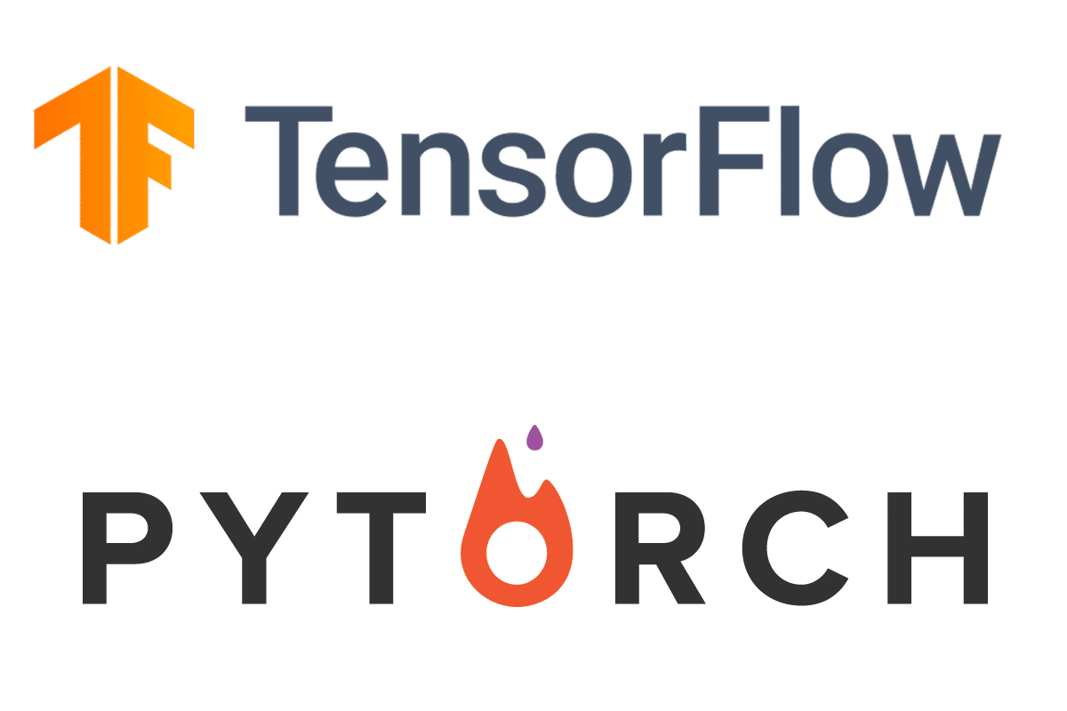
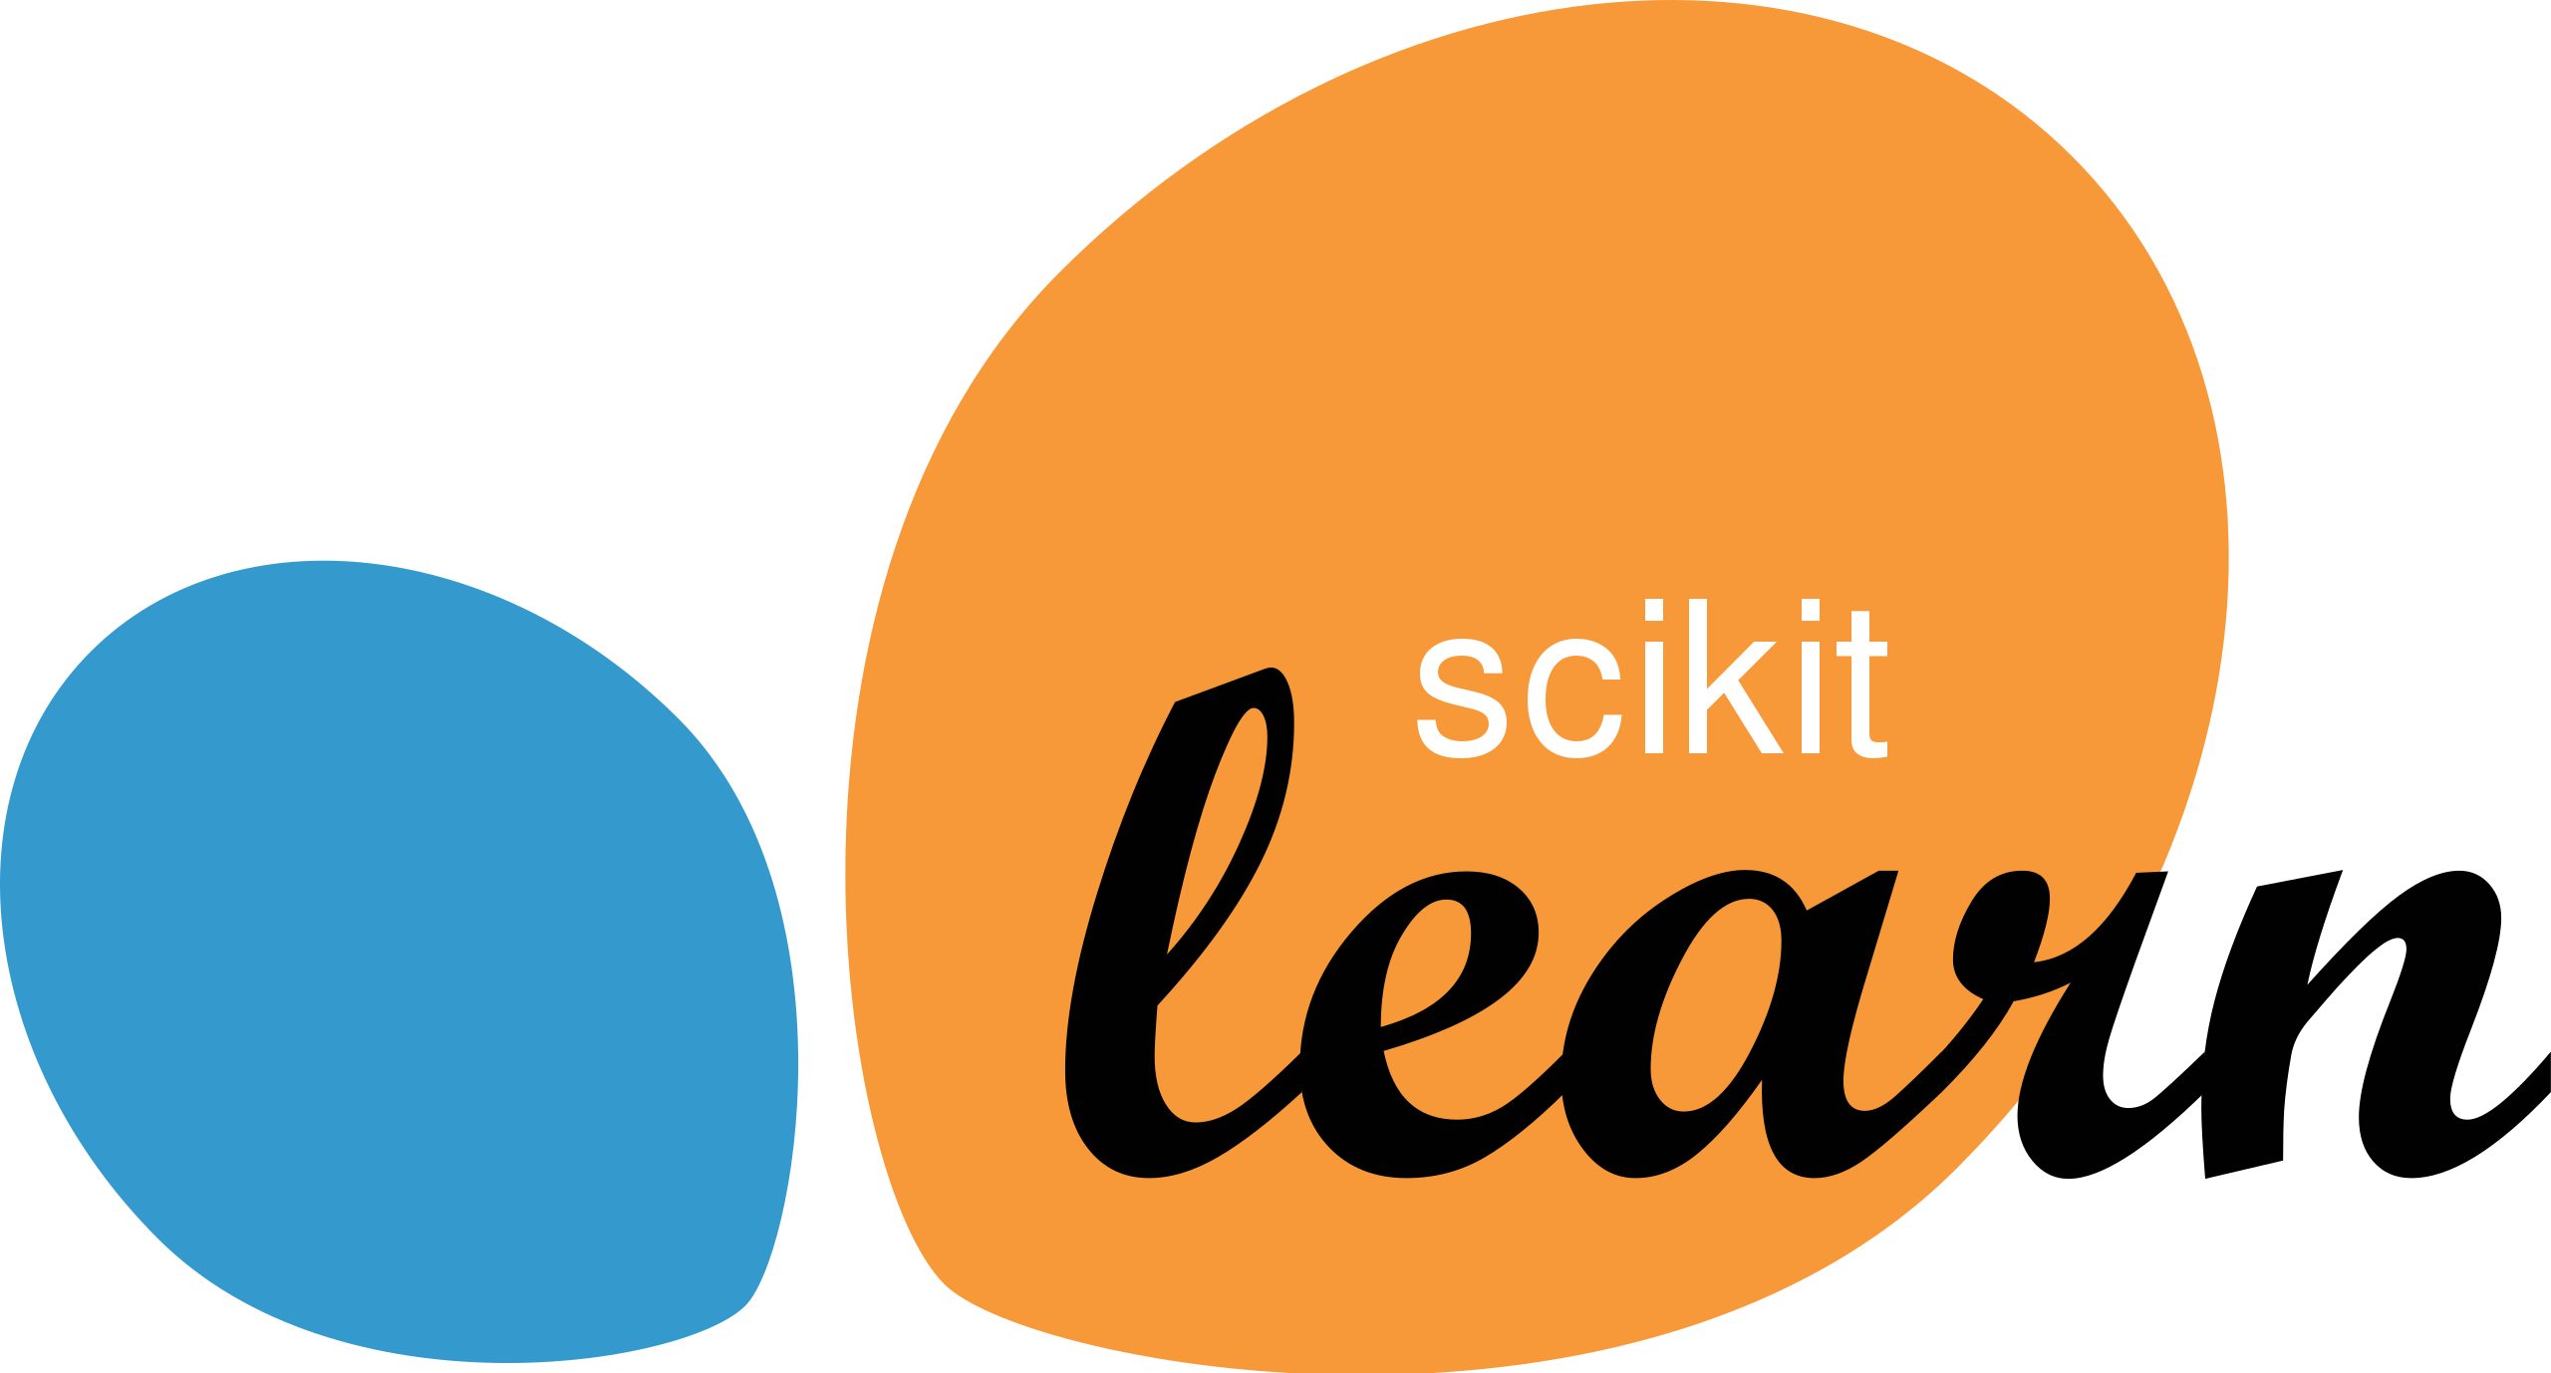
ML / DL Comparison
Machine Learning
Deep Learning
1990’s - Present
2010 - Present
Statistics & Math
Artificial Neuron
Sci-Kit Learn / RAPIDS
Tensorflow / Pytorch
Notes:
Although deep learning is classified as a subfield of machine learning, these two fields differ in significant ways. Let’s consider three differences right now.
ML algorithms rose to prominence in the 1990’s, with advances in computer hardware. Deep learning, on the other hand, came into its own shortly after 2010. The deep learning revolution, as we now call it, was powered by three things: Graphic Processing Units (GPUs), big data, and deep learning frameworks.
The inspiration for machine learning algorithms came from statistics and mathematics. While deep learning was inspired by the anatomy of the brain, specifically the neuron. Indeed, the distinguishing feature of deep learning models is the presence of artificial neurons arranged in layers.
The development tools between these two fields differ as well. Sci-Kit Learn and RAPIDS are popular frameworks in machine learning. Whereas Tensorflow and Pytorch are favored on the deep learning side.
[NEXT SLIDE]
=====
SciKit Learn Image
https://commons.wikimedia.org/wiki/File:Scikit_learn_logo_small.svg
TensorFlow / PyTorch Image
https://www.aws.ps/pytorch-vs-tensorflow-machine-learning-frameworks-comparison/

Slide 19
Deep Learning Improved Image Classification 10% in 1-year
35
30
28.2%
25.8%
~10%
25
20
16.4%
15
Human level
performance 5.1%
11.7%
10
6.7%
3.6%
3.1%
5
0
ILSVRC’10
ILSVRC’11
(XRCE)
ILSVRC’12
(AlexNet)
ILSVRC’13
(ZF)
ILSVRC’14
(GoogLeNet)
ILSVRC’15
(ResNet)
ILSVRC’16
(GoogLeNet-v4)
Source: https://becominghuman.ai/a-summary-of-industry-ready-state-of-the-art-computer-vision-techniques-a7f2b893de2f
Notes:
As I mentioned in the last slide, deep learning really got going around 2010. The ImageNet Large Scale Visual Recognition Challenge (ILSVRC) is the world’s premier competition for assessing state-of-the-art vision models. AlexNet – a deep learning model – crushed the competition in 2012, achieving about a 10% decrease in image classification error from the previous year’s winner. AlexNet was the only deep learning model in the 2012 competition. Overall, the introduction of deep neural networks has resulted in a 10-fold reduction in image classification errors.
[NEXT SLIDE]
=====
ILSVRC: Large Scale Visual Recognition Challenge - uses the famous ImageNet dataset – 14 million labelled images.
The deep neural network breakthrough happened in 2012 – a roughly 10% decrease in image classification error (from 25.8% in 2011 to 16.4% in 2012).
In 2015, state-of-the-art deep learning algorithms surpassed human level performance for image classification (5.1%) with an accuracy of 3.57%.
Overall, the introduction of deep neural networks resulted in a 10-fold reduction in image classification error (from 25.8% in 2011 to 2.3% in 2017).

Slide 20
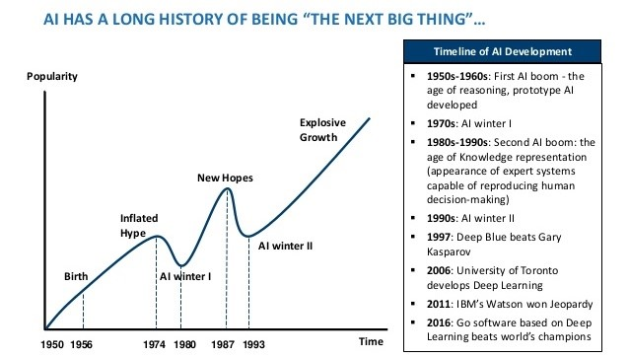
AI Has a Long History of Being “The Next Big Thing”…
Image Credit: https://www.mdpi.com/2079-9292/10/4/514/htm
Notes:
Unfortunately, progress in AI has been uneven. The field has experienced multiple winters, periods when interest in and funding for AI disappeared.
1st AI winter: mid-1970’s – Marvin Minsky & Seymour Papert argued in their book (Perceptrons) that neural networks had significant limitations.
2nd AI winter: early-1990’s – At that time, expert systems were the next big thing. But most of these systems failed because they were too difficult to construct and maintain
Hype is the problem. It’s about over-promising and under-delivering. But here are some key points:
AI is seductive. Intelligence is an interesting subject, one that humans have been thinking about for a long time.
AI researchers have been making progress since the 1950s. The field continues to move forward.
AI winters aren’t really about AI failures per se. AI technologies, including many “failures” are still widely used today.
[NEXT SLIDE]

Slide 21
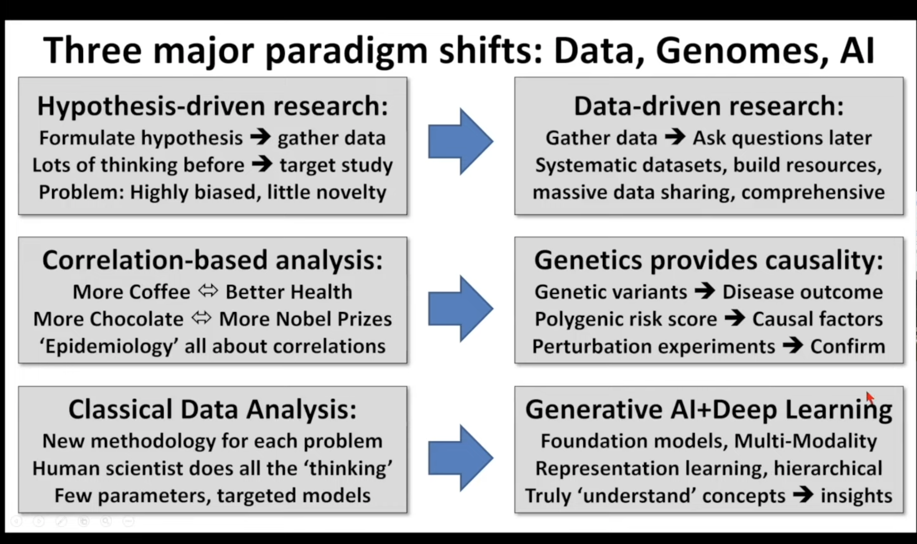

Slide 22
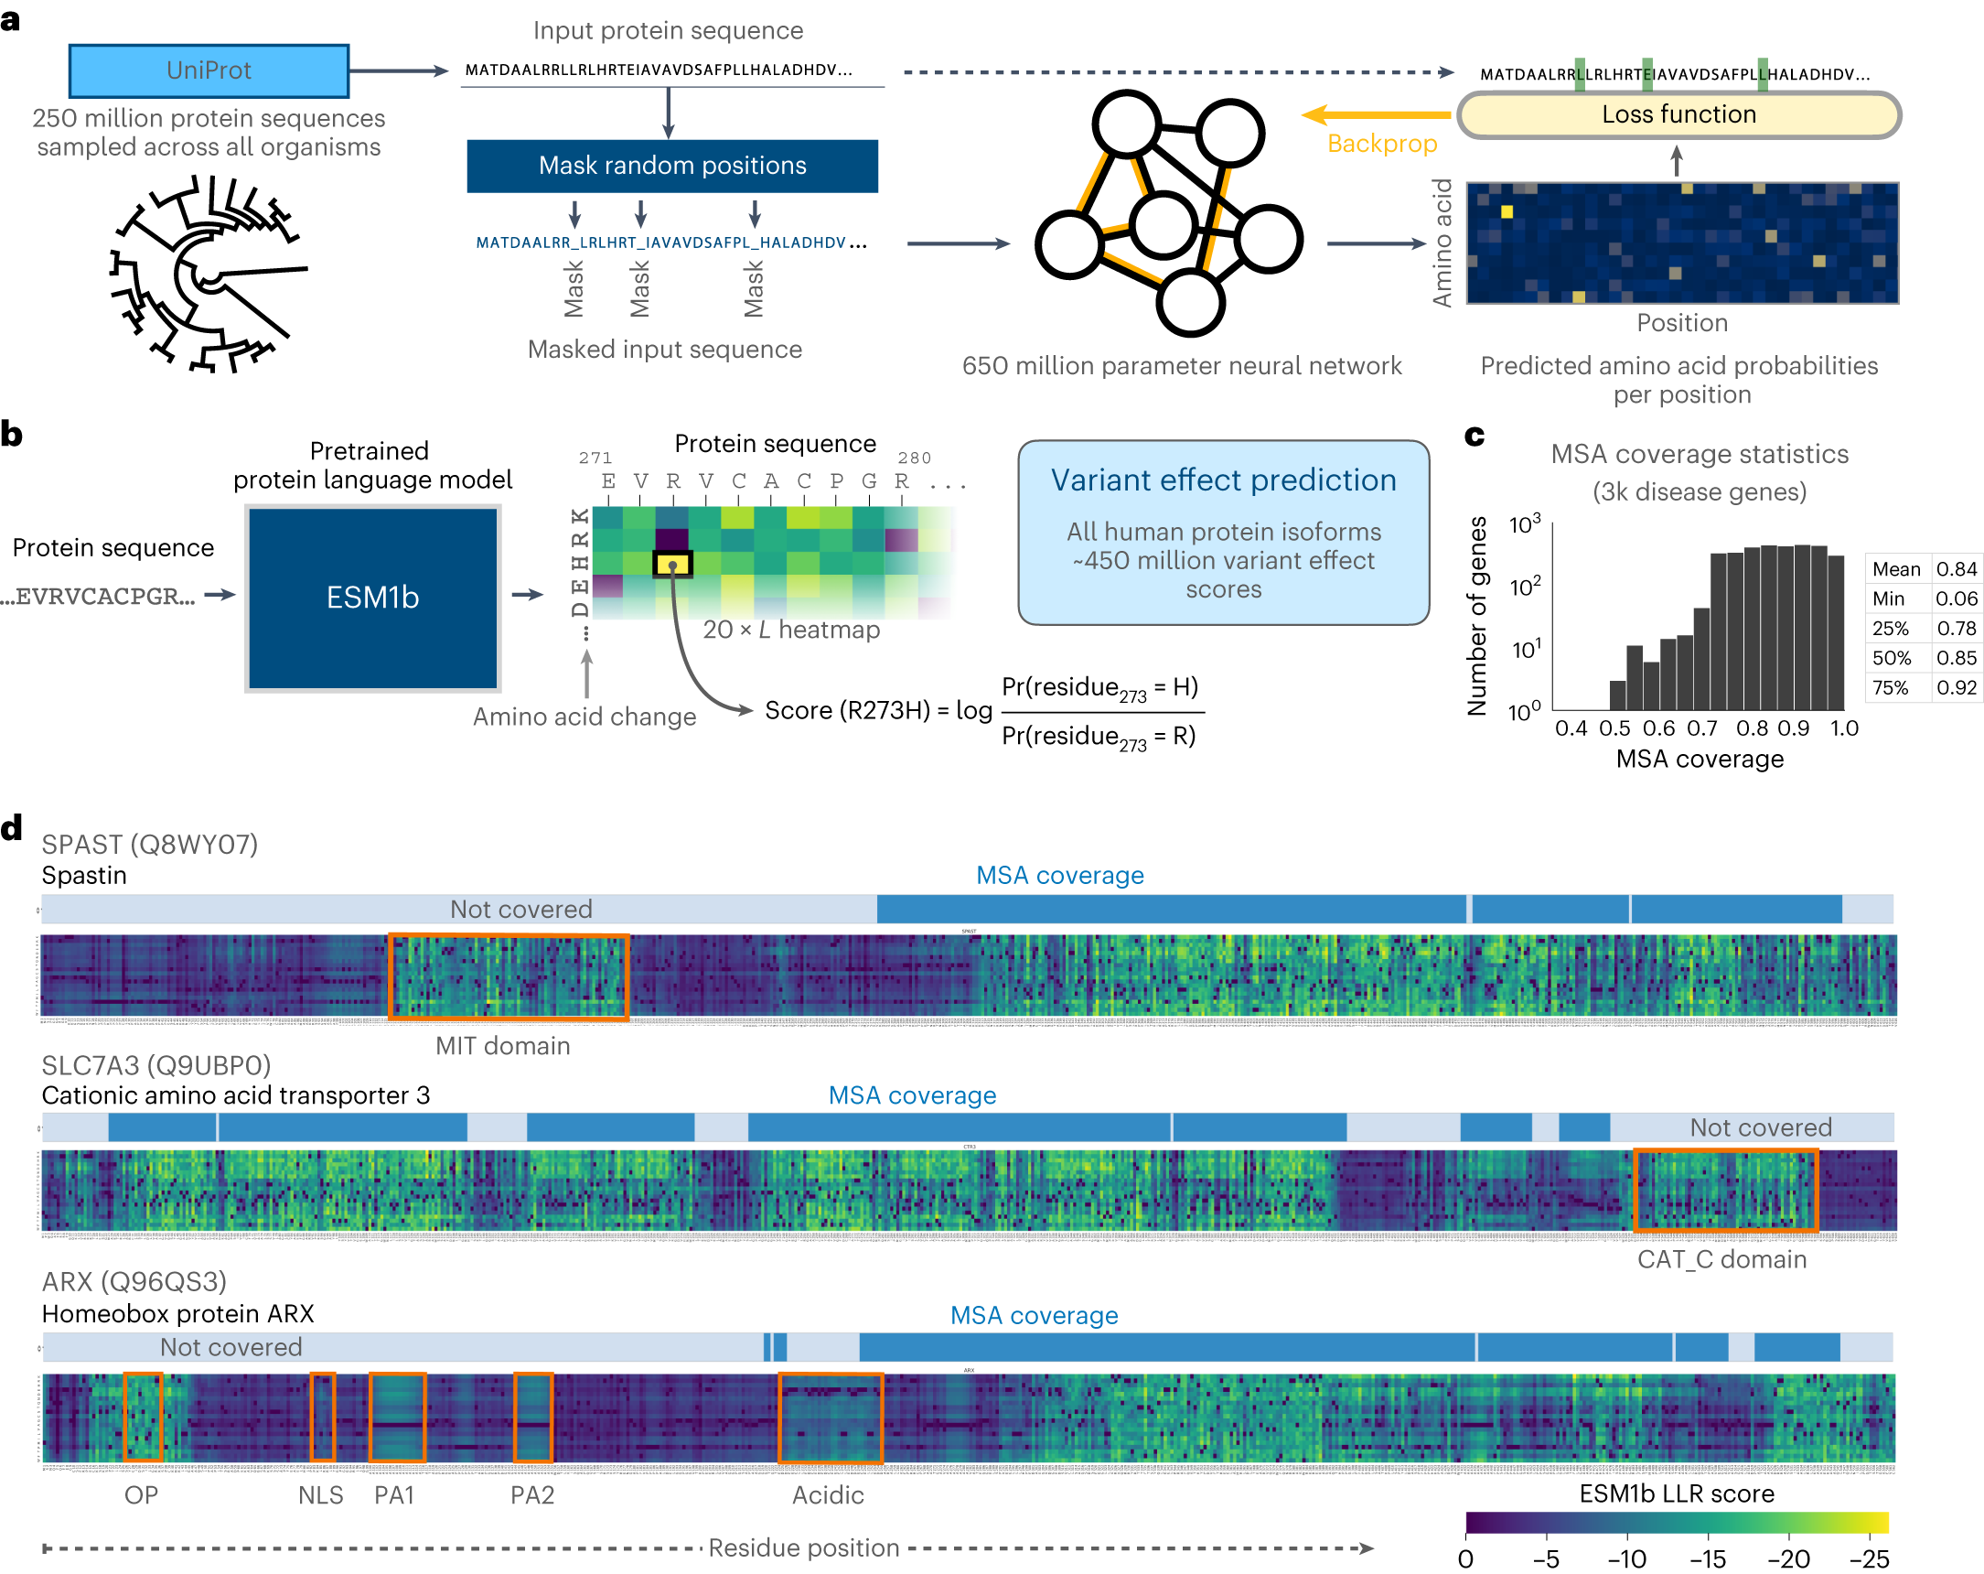
https://doi.org/10.1038/s41588-023-01465-0

Slide 23
